Slide 1
REPORT WRITING

Slide 2
Objectives for writing reports:
Supply a record of work accomplished
Present information to a large number of people
Record problems encountered
Document schedules, timetables and milestones
Recommend future action
Document current status
Record procedures

Slide 3
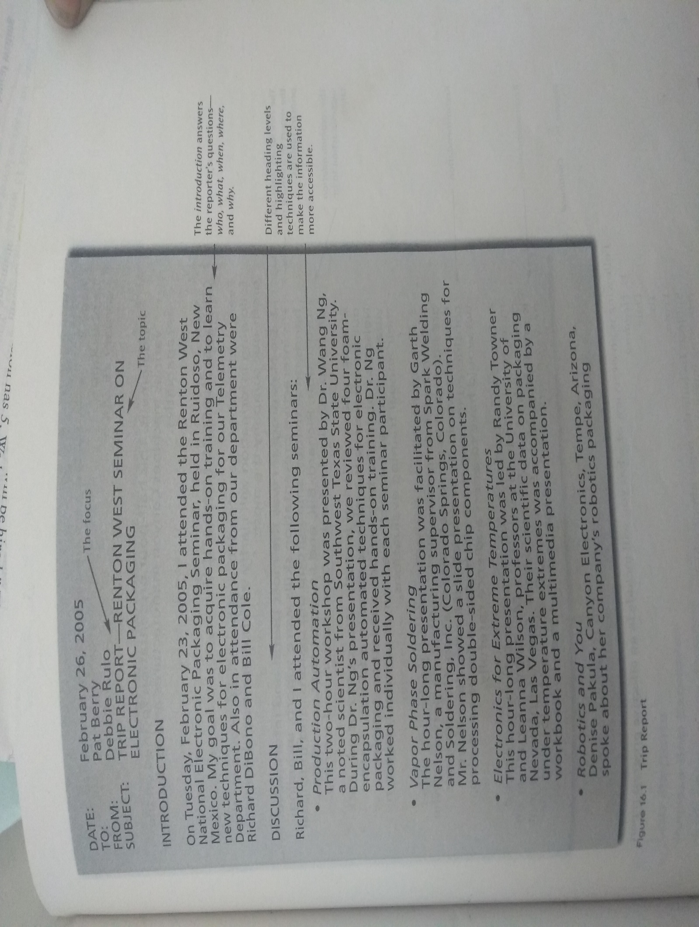

Slide 4
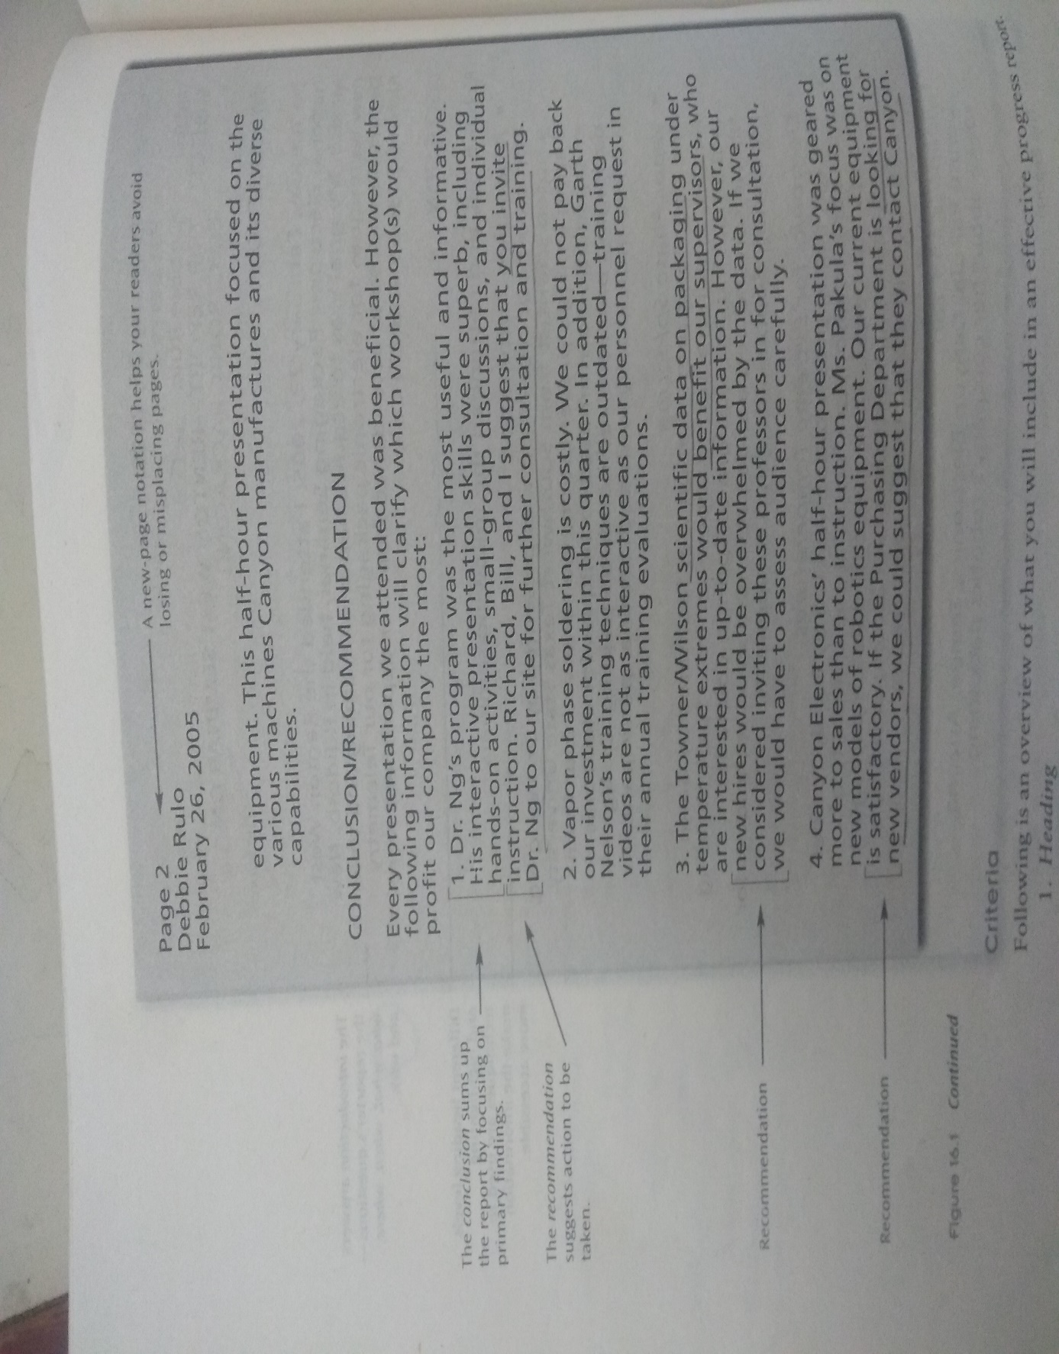

Slide 5
Criteria for writing reports
Organization: heading, introduction, discussion and conclusion/recommendations
Heading: Date, To, From, Subject( all Caps)
Introduction: Purpose( why are you writing the report)-rationale, justification, objectives)
Personnel: Names of other people involved in the report
Date: What period of time the report covers

Slide 6
Example_ Objectives-I attended the National Electronic Packaging Conference at____,to ______
Dates: April 5-10,2020
Personnel- names who attended

Slide 7
Discussion
Summarizes the activities and the problems encountered.
This is the largest section of the report.
Conclusion/recommendations
The conclusion allows you to sum up, to relate what have you learnt, or what decisions have you made regarding the activities reported. The recommendations suggest future actions, what you believe and what the company should do.
Example : The conference was beneficial. I learnt the different soft wares that could be used in routine in our company as it would save time and money. I recommend to buy these soft wares for all our computers.

Slide 8
Development:
Whom did you meet/contact/liaison with
When did the activities occur?
Why are you writing the report?
Where did the activity take place?
What were the steps in the procedure?
Quantify do not be vague.
Sample: Installation of the machinery is needed to replace a piece of equipment deemed unsatisfactory by an Equipment Engineering review.
The exposure table needs to be installed by 9/05 so that we can manufacture printed wiring products with fine line paths and spacing (down to 0.0005 inch). The table will replace the outdated printer in Dept.76.Failure to install the table will slow down the production schedule by 27%.

Slide 9
Style
Conciseness, simplicity, highlighting techniques.

Slide 10
TRIP Reports
Job related travel to document expenses, time off from the office, and updating of activities.
Criteria
Heading( Date/To/From/Subject)
Introduction(overview/Background)
Purpose: destination, objectives, rationale.
Personnel: who all were there?
Authorization: who recommended or suggested.
Discussion: (body,findings,agenda) Using subheadings, document your activities. This can include a review of your observations, contacts, seminars attended, or difficulties encountered.
Recommendations/conclusion_ what did you accomplish, learn, what benefits occurred to you and the team.Recommendation.

Slide 11
Progress report
Criteria
Heading/Date/From/Subject( include the topic of reporting and the duration).
Objectives: rationale(why)/ what problems motivated the project/what do you hope to achieve? , who initiated the activity?
Personnel: who are your team mates?
Update: if this is the third or fourth report of the same work mention what was accomplished earlier.
Discussion:
Work accomplished: itemize your work in chronological order
Work remaining( may use graphic organizers)
Problems encountered: justify why are you behind schedule, where would you need help

Slide 12
Conclusions/Recommendations: Sum up what have you achieved during this period and provide target completion date.
Recommendations: recommend changes in schedule, personnel. budget or materials that will help your deadlines.

Slide 13
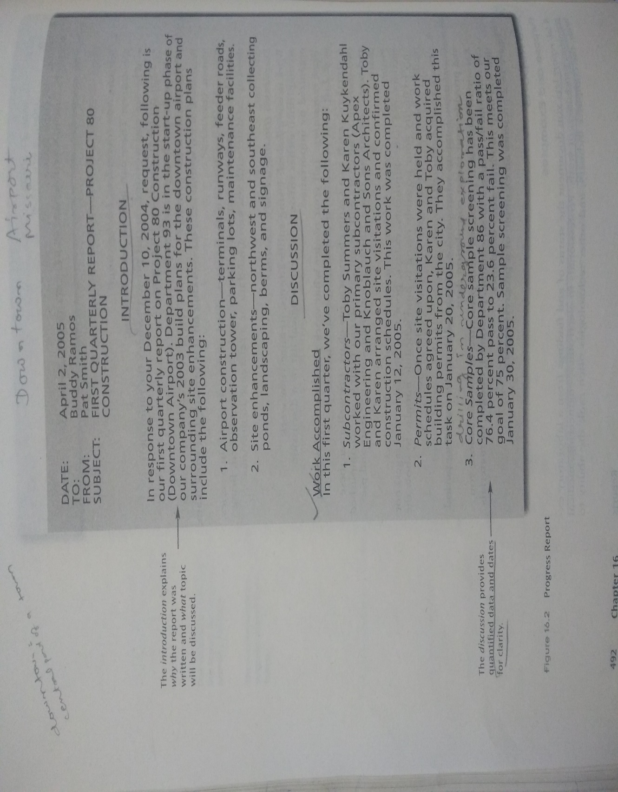

Slide 14
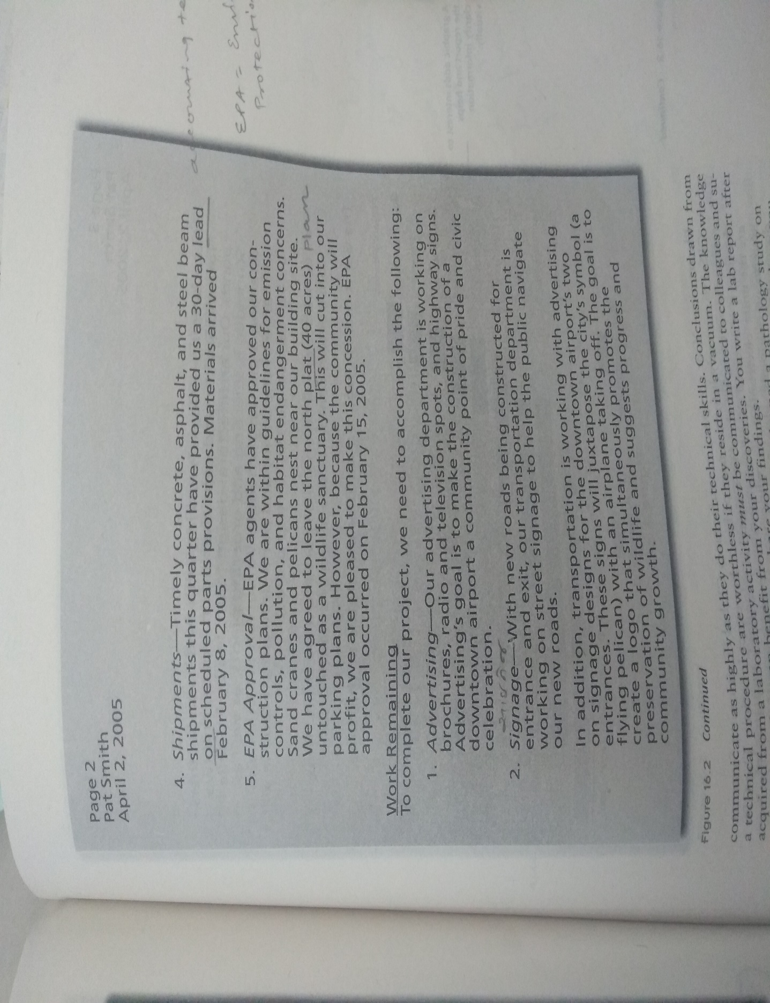

Slide 15
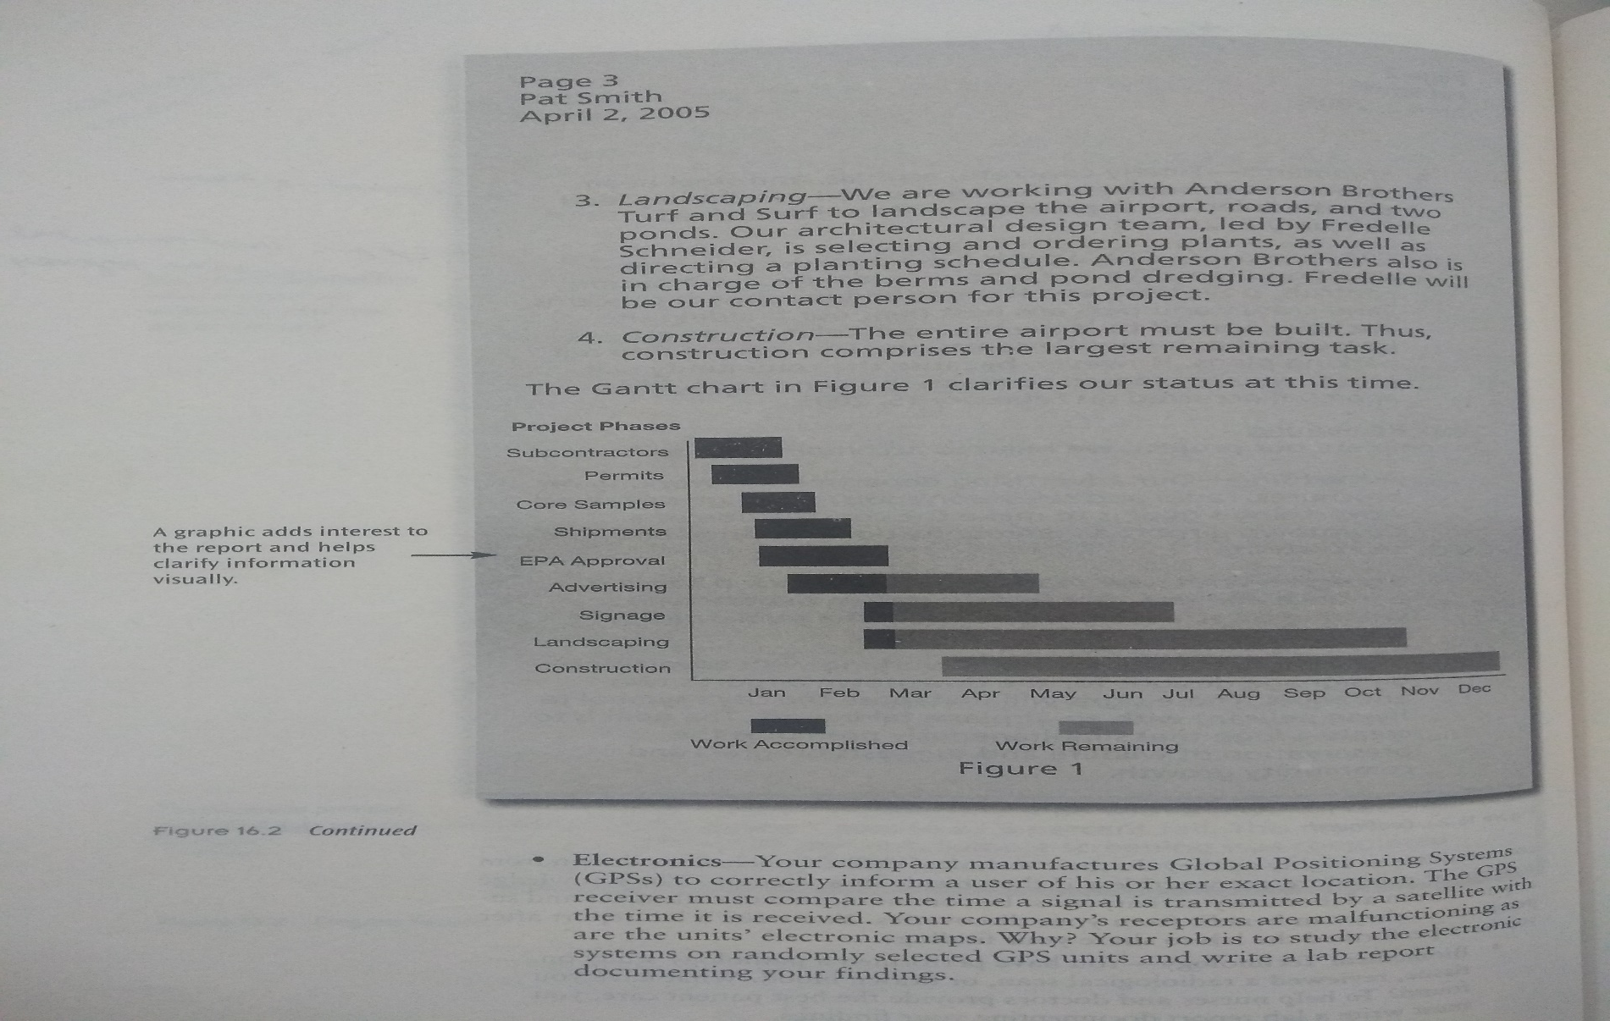

Slide 16
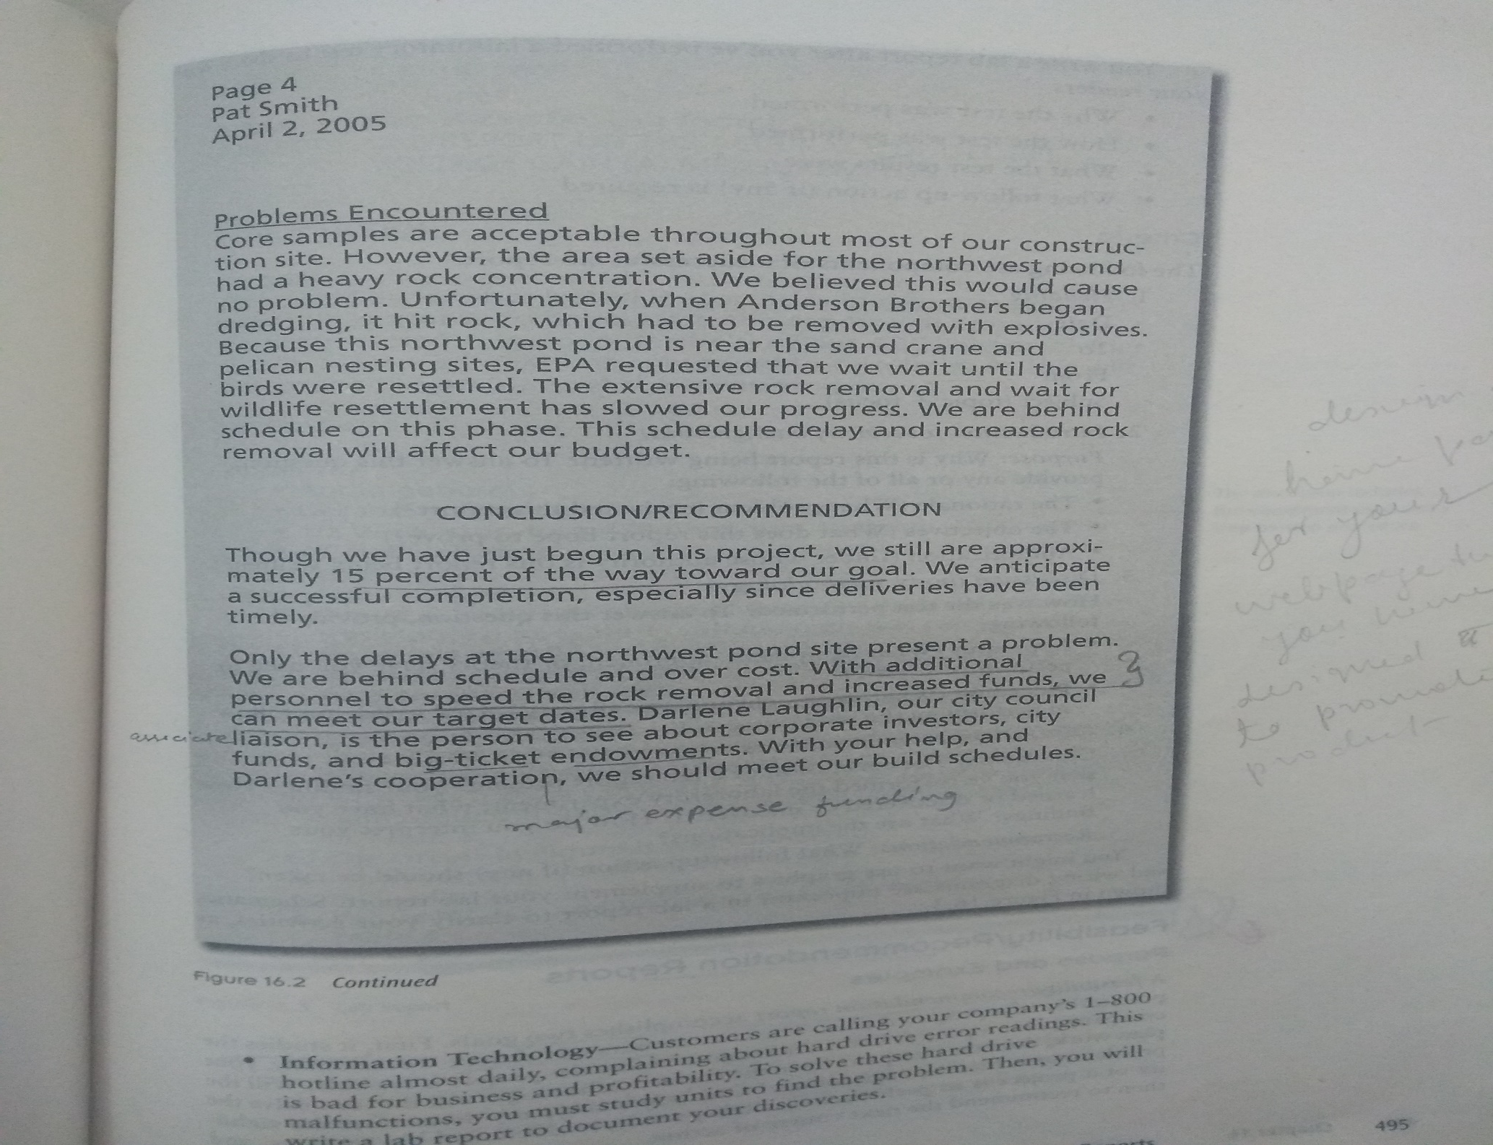

Slide 17
